Slide 1



ARRAY
Topic 6

Slide 2
Variable vs Array
VARIABLE
name
Ali
ARRAY
name
Ali
Lim
Siva
[0] [1] [2]

Slide 3

What is Array?
A structured data type with a fixed number of components.
Every component is of the same type.
Components are accessed using their relative positions in the array: index.
Types of array
One-Dimensional array
Two-Dimensional array
Multi Dimensional array

Slide 4
One-Dimensional Array Declaration
Syntax to declare an array:
<dataType>[] <arrayName> = new <dataType>[intSize];
Or
<dataType> <arrayName>[]= new <dataType>[intSize];
dataType : a type of data that will be stored in
array or component type
arrayName : a reference variable for array
intSize : size of an array (> 0)

Slide 5
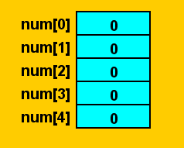
Example
int[] num = new int[5]; or
int num[] = new int[5];
num
This statement declares and creates the array num of size 5.
Each element is int data type.
The elements will be placed at num[0], num[1], num[2], num[3], num[4]
The value in square bracket [ ] is called index and it starts at 0

Slide 6
Continued…
elements
indexes
In Java, [ ] is called as array subscripting operator
Items in an array is called elements

Slide 7
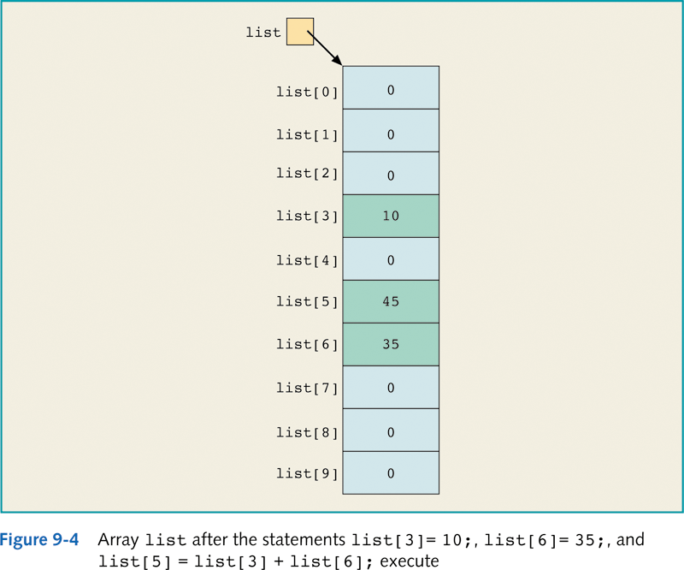
Assigning values into an array
int[] list = new int[10];
0
0
0
0
0
0
0
0
0
0
Assume the declaration as above.
Statement;
list[3] = 10;
list[6] = 35;
list[5] = list[3] + list[6];
will store 10, 45 and 35 into the array in list[3], list[5] and list[6] respectively.

Slide 9
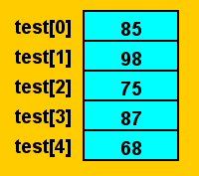
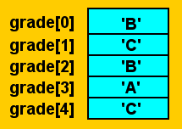
More Examples
Array of five integers called test
Array of five characters called grade
test[0] = 85;
test[1] = 98;
test[2] = 75;
test[3] = 87;
test[4] = 68;
grade[0] = ‘B’;
grade[1] = ‘C’;
grade[2] = ‘B’;
grade[3] = ‘A’;
grade[4] = ‘C’;

Slide 10
Specifying Array Size during Runtime
We can also specify the size of the array during runtime.
int arraySize;
System.out.print("Enter the size of the array: ");
arraySize = input.nextInt();
int[] list = new int[arraySize];
The system use the value of arraysize to instantiate the object list

Slide 11
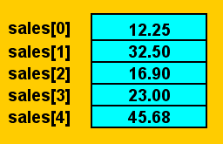
Array Initialization during Declaration
We also can assign a value into the array during declaration
double[]sales = {12.25, 32.50, 16.90, 23.00, 45.68};
The values called initial values, are placed between braces and separated by commas.
When declaring and initializing arrays, the size of the array is determined by the number of initial values within the braces.
If an array is declared and initialized simultaneously, we do not use the operator new to instantiate the array object.

Slide 12
Arrays and the length
We can use length to know the size of an array.
The length can be directly accessed in a program using the array name and the dot operator.
int[] arrayNumber= {10, 20, 30, 40, 50, 60};
This statement creates the array list of six components and initializes the components using the values given.
Here arrayNumber.length is 6. You may write the code as:
System.out.println("The size is " +arrayNumber.length);

Slide 13

Accessing Elements in Array
Syntax to access an array element:
arrayName[subscript]
int accessedValue = a [2];
System.out.println("The value in index 2 is " +accessedValue);
OR
System.out.println("The value in index 2 is " +a[2]);

Slide 14
Array of String
String[] nameList = new String[5]
nameList[0] = "Amanda Green";
nameList[1] = "Vijay Arora";
nameList[2] = "Sheila Mann";
nameList[3] = "Rohit Sharma";
nameList[4] = "Mandy Johnson";

Slide 15
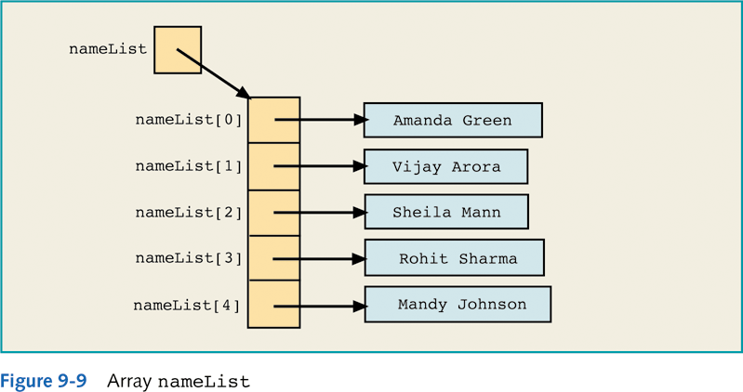

Slide 16
Exercises
In a class, declare an array of type integer, its size is 3.
Ask input from user to enter 3 integers and keep these integers in the array.
Create another array of type String that keeps 5 computer brands: Asus, Acer, Sony, Lenovo and HP. Then, display the length of the array and the elements in indexes [3] and [4].
Ask input from user for the number of pets that he/she wants to save in an array. Then declare another array with the size based on the input that the user gives.

Slide 17
Loops and Arrays
Loops can be used to process array in several ways:
1. Initializing an array to a specific value
2. Input data into an array
3. Printing the elements in an array
4. Find the sum and average of an array
5. Determine the largest element in the array
6. Search for an element in the array.
7. Update an element in the array.
8. Delete an element in the array.

Slide 18
Initializing an Array to a Specific Value
Example:
To initialize every component of the array sales[] with value of 10.00
double[] sales = new double[3];
int index;
for (index = 0; index < sales.length; index++)
sales[index] = 10.00;

Slide 19
2. Input data into an array
Example:
To input double numbers into array sales[]
double[] sales = new double[3];
int index;
for (index = 0; index < sales.length; index++)
{ System.out.print("Enter number " +(index+1)+ ": "); sales[index] = input.nextDouble(); }

Slide 20
Example:
To print the values stored in array sales[]
double[] sales = {100, 350, 400};
int index;
for(index = 0; index < sales.length; index++)
{
System.out.println("Element in index ["
+ index + "]: " + sales[index]);
}
3. Printing the elements in an array

Slide 21
double[] sales = {10,20,30}; int index; double average, sum=0.00; for(index = 0; index < sales.length; index++) { System.out.print("Enter number " +(index+1)+ ": "); sales[index] = input.nextDouble(); sum = sum + sales[index]; } if (sales.length != 0) average = sum / sales.length; else average = 0.0; System.out.println("The sum value is " +sum); System.out.println("The average value is " +average);
4. Find the sum and average of an array

Slide 22
double[] sales = new double[4]; int index, maxIndex; double largestSale; maxIndex = 0; for(index = 0; index<sales.length; index++) {
System.out.print("Enter sale " +(index+1)+ ": RM "); sales[index] = input.nextDouble(); if (sales[maxIndex] < sales[index]) maxIndex = index; } largestSale = sales[maxIndex]; System.out.printf("The largest sale is RM %6.2f", largestSale);
5. Determining the largest element in the array

Slide 23
int arrayLength=4 , flag = 0; String [] mobileBrand = {"iPhone","Samsung","Oppo","Lenovo"}; System.out.print("Enter the mobile phone brand that you want to search:"); String searchBrand = input.nextLine(); for (int i = 0; i < arrayLength ; i++) { if(mobileBrand[i].equals(searchBrand)) { System.out.println("You Searched for "+ mobileBrand[i] +
", it is in index " +i); flag = 1;
break; } }//for if(flag==0) System.out.println("The brand does not exist");
6. Search an Array Element

Slide 24
int arrayLength=4 , flag = 0; String [] mobileBrand = {"iPhone","Samsung","Oppo","Lenovo"};
System.out.print("Enter the mobile phone brand that you want to update:"); String searchBrand = input.nextLine(); for (int i = 0; i < arrayLength ; i++) { if(mobileBrand[i].equals(searchBrand)) { System.out.println("You want to update "+ searchBrand +
", it is in index " +i); System.out.print("Enter the new brand that you want to replace with " + searchBrand + ": "); String updateBrand = input.nextLine(); mobileBrand[i] = updateBrand; flag = 1;
break; } }//for if(flag==0) System.out.println("The brand does not exist");
7. Update an Array Element

Slide 25
import java.util.Scanner; public class DeleteStud { public static void main(String[] args){ Scanner input = new Scanner(System.in); int i,j; boolean delete=false; String [] studName = {"Sharifah","Syed","Tengku","Wan","Ina"}; int arrayLength = studName.length; System.out.print("Enter the student name that you want to delete:"); String deleteName = input.next(); for (i=0; i < arrayLength; i++){
if(studName[i].equals(deleteName)){ for(j=i;j< arrayLength-1;j++) studName[j]=studName[j+1]; delete=true; break;
}//if }//for if (delete==false) System.out.println("The search value is not in the list."); } }
8. Delete Array Element

Slide 26
Array Index Out of Bounds
An array is in bounds if:
index >= 0 OR index <= arraySize – 1
An array is in out bounds if:
index < 0 OR index >= arraySize
If an array is out of bounds;
i. ArrayIndexOutOfBoundsException exception is thrown.
ii. The program will terminate with an appropriate
error message

Slide 27
Example: Array Index Out of Bounds
Consider the following declaration:
The component num[i] is valid if i = 0, 1, 2….9
When i < 0 or i >= 10, the component num[i] is invalid (the index is out of bounds)
double[] num = double[10];
int i;

Slide 28
Example: Array Index Out of Bounds
Consider the following loops
for (int i = 0; i <= 10; i++)
list[i] = 5;
When i = 10;
list[10] = 5;
The program tries to access list[10] but does not exist
We say the index is out of bound
5
list[0]
list[1]
5
list[2]
5
list[3]
5
list[4]
5
list[5]
5
list[6]
5
list[7]
5
list[8]
5
list[9]
5

Slide 29
Two-dimensional Array
32
A collection of a fixed number of components arranged in rows and columns.
All components are in same type.
Data is sometimes in table form (difficult to represent using a one-dimensional array).
10 | 11 | 21 | 45
20 | 22 | 42 | 34
30 | 33 | 66 | 21
40 | 44 | 84 | 32
50 | 55 | 105 | 13
60 | 66 | 126 | 21
70 | 77 | 147 | 33
80 | 88 | 168 | 22
90 | 99 | 189 | 123

Slide 30
Two-dimensional Array Declaration
Syntax:
dataType[ ][ ] arrayName = new data Type[intRow][intCol];
intRow → number of rows
intCol → number of columns
intRow and intCol > 0
Example:
double[ ][ ] sales = new double[10][5];

Slide 31
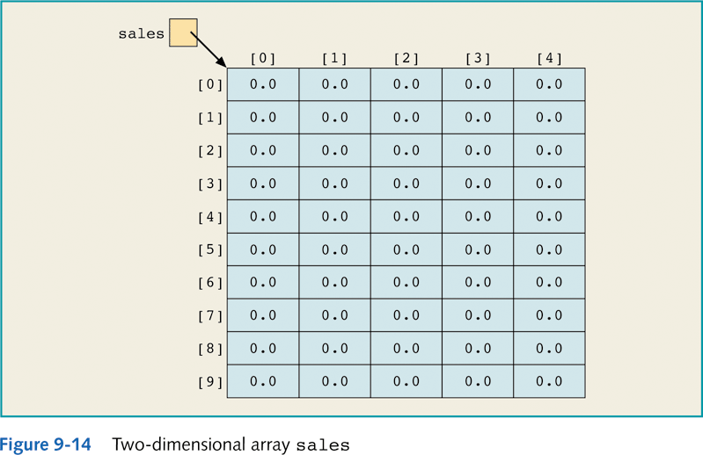
34
double[ ][ ] sales = new double[10][5];

Slide 32
Accessing Array Components
To access a component of a two-dimensional array:
arrayName[indexExp1][indexExp2];
indexExp1 = row position
indexEXp2 = column position
Example:
The statement below stores 25.75 into index number 5 and index number 3; (the 6th row and the 4th column)
sales [5][3] = 25.75;

Slide 33
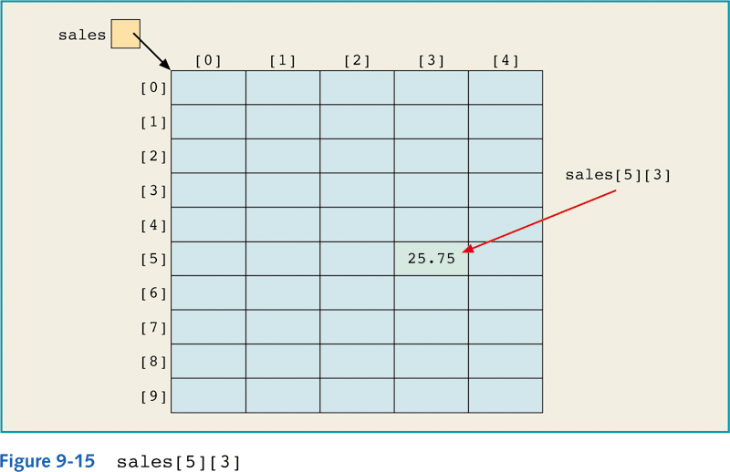
36
sales [5][3] = 25.75;

Slide 34
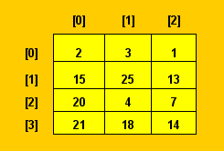
Array Initialization During Declaration
Two-dimensional array can be initialized during declaration
Example:
int[ ][ ] board = { {2,3,1},
{15,25,13},
{20,4,7},
{11,18,14}};
board

Slide 35
Processing Two-dimensional Array
Example:
Initialization
Print
Read
Find the average of all elements
Find the largest element
Suppose the declaration as below:
int row;
int col;
int matrix [][] = new int[7][6];

Slide 36
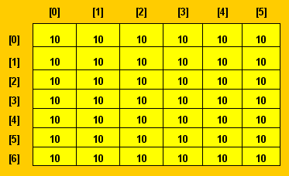
Example: Initialization
for (row = 0; row < matrix.length; row++)
for (col = 0; col < matrix[row].length; col++)
matrix[row][col] = 10;
matrix

Slide 37
Example: Print & Read Data
Print
for (row = 0; row < matrix.length; row++)
for ( col = 0; col < matrix[row].length; col++){
System.out.println(matrix[row][col] + " ");
System.out.println();
}
Read Data
for (row = 0; row < matrix.length; row++)
for (col = 0; col < matrix[row].length; col++)
matrix[row][col] = scan.nextInt();

Slide 38
Example: Find Average of All Elements
int row, col, noOfElement =0; double sum=0.0, avg; double sales [][]= {{100.0, 20.0, 350.0}, {150.0, 30.0, 40.0}, {100.0, 50.0, 50.0}};
for (row = 0; row < sales.length; row++) for (col = 0; col < sales[row].length; col++){ sum += sales[row][col]; noOfElement++; } avg = sum/noOfElement; System.out.printf("Average of all elements is%.2f " ,avg);

Slide 39
Example: Largest Element in Each Row
for (row = 0; row < matrix.length; row++)
{
largest = matrix[row][0];
for (col = 1; col < matrix[row].length; col++)
{
if (largest < matrix[row][col])
largest = matrix[row][col];
}
System.out.println("The largest element of row" + (row+1)
+ "=" + largest);
}

